Slide 1
Students Receive Technical Education to Become Most Successful:
Work Hard and Smart
Notes:
Introduce myself as Zach Preston, I am part of the AMT Program. My Toyota personal safety commitment is to not walk with my hands in my pockets.
Today some people continue to believe that the most successful people go to a four year college directly out of high school; however, industry leaders are looking for employees who have hands-on technical skills that are needed to improve the industry. Every student should receive some specialized technical education while in high school before getting a bachelor’s degree to become the most successful.

Slide 2
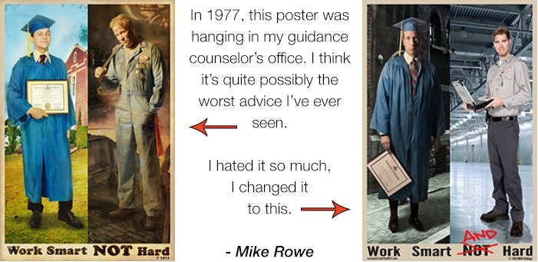
Is a higher college education really worth the time and money?
Notes:
Taken from the photo educated people in the 1970s wanted people to believe that workers in skilled trades were uneducated and did not make much money, and the only way to success was a 4 year education.
Today a four year education has left some people jobless and just trying to survive. On the other hand, highly skilled trade jobs have put people to work with just a short term technical degree.
Ok, ok, you believe that I am trying to talk you out of a higher education. Absolutely not, but I do believe every student should experience a technical education in order to receive hands-on and possible workplace experience.

Slide 3
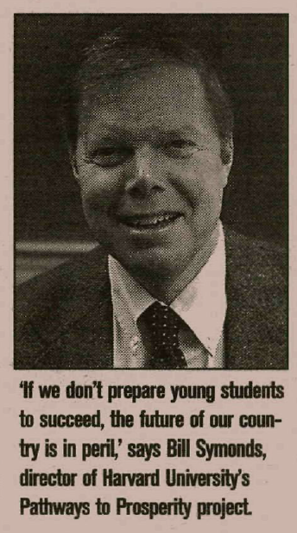
Pathway to Prosperity
“If we don’t prepare our young students to succeed, the future of our country is in peril.”- Bill Symonds Harvard’s Pathway to Prosperity Project.
“College for all” is popular phrase, but 1/3 achieve a four year degree.
Notes:
Pathway to Prosperity was a project designed to help students and parents consider the options regarding education and the industry in the times we live in today.
Read quote.
College is not for everyone, but everyone must find a place, a niche in their community to become a better citizen. This is the reason skilled trades offer students much more than a fancy piece of paper.

Slide 4
The “connection” between the workplace and education.
In the 1900s students studied English, arithmetic, science, and history then they went straight into the workforce.
In the 1970s, schools pushed students to go to college and it split the gap between industry and education.
As of the 1990s the America’s educational system has worked towards school and work opportunities.
Carl Perkins Act helped universities, businesses, and secondary schools communicate to offer students a quality higher education.

Slide 5
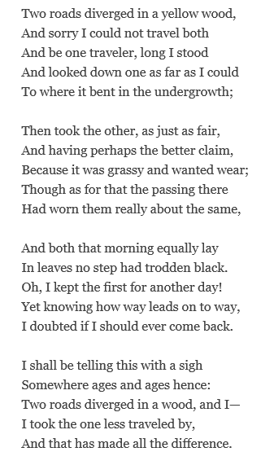
“The Road Not Taken”
People must make life affecting decisions.
There are ways that are “worn” and “fair”
But the one you could take may be “the one less traveled by, and it made all of the difference.”
There are many pathways to success!

Slide 6
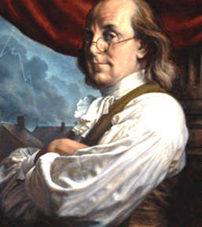
Why study a skilled trade?
“Tell me and I’ll forget”
“Teach me and I may remember”
“Involve me and I will learn”
-Ben Franklin
Notes:
A skilled trade is something greater than a piece of paper because you have a talent that can be proven by your technical skills.

Slide 7
Secondary Education and Project Based Learning
Project-Based Learning is a student led and teacher supported approach to learning.
Students beg to do a project that involves hands-on activities that require collaboration, communication, and problem solving skills to complete.
Integrating STEM Education which involves “pragmatism, constructivism, and goal orientation theory.”
Notes:
STEM Science, Technology, Engineering, and Mathematics based learning.
Programs like Project Lead the Way helps incorporate a curriculum based around STEM to give students an introduction to a possible job in that type of field of study.

Slide 8
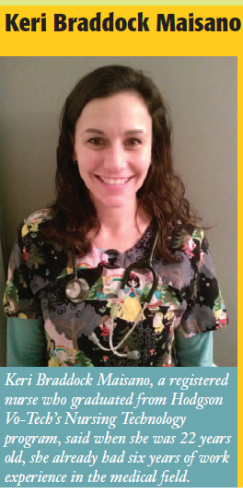
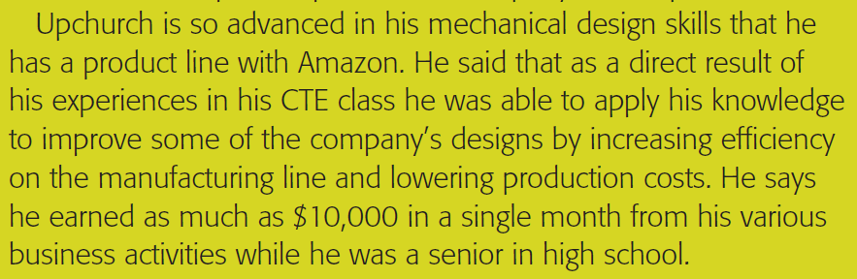
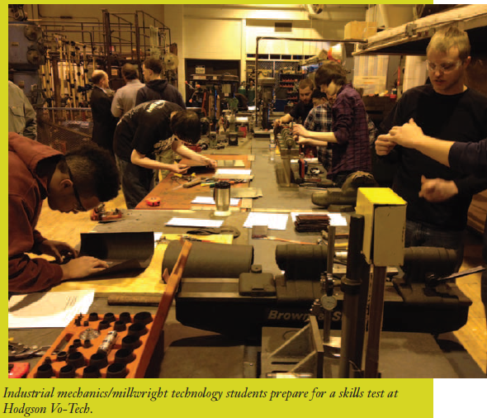
Success Stories
Ryan Upchurch

Slide 9

What does it mean to get a college education?
Students go to a four year college to learn in order to get a job after graduation. However, students receive a technical degree with work related and classroom based experience.
People must get their “foot in the door” with businesses.
If students study and work in their field of study, they are less likely to drop out.

Slide 10
How much debt should someone incur for an education?
Financing a higher education is a “complex endeavor”
Price of Education= Human capital investment
Two year programs are less expensive, and provide students with an opportunity to work in their field of study.

Slide 11
What should you do?
Define “being successful” in your terms
Truly “Work Hard and Smart!”
Always remember, “It doesn’t matter where you are coming from, all that matters is where you are going.” –Brian Tracy

